Slide 1
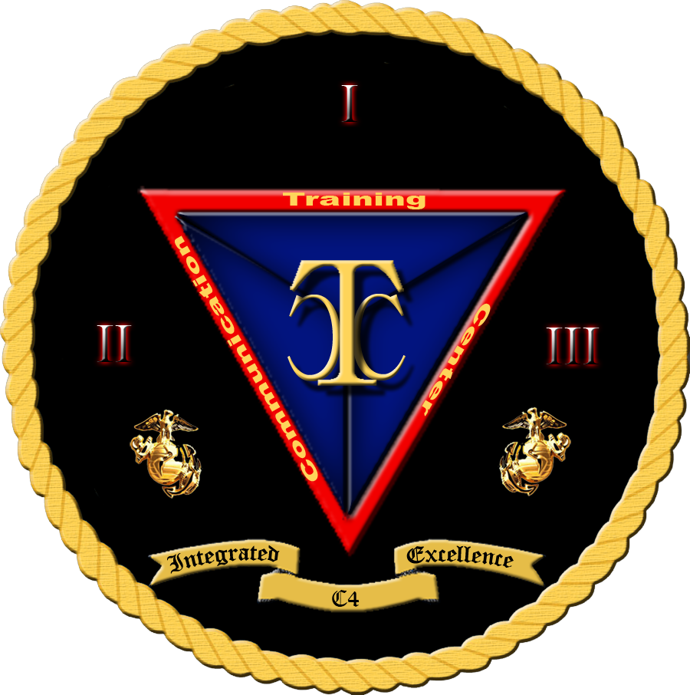

Security+
Exam SY0-601
Chapter 14
Embedded and Specialized Systems
Notes:
Gain Attention

Slide 2
Chapter 14 (Domain 2.6) Learning Objectives
Explain the security implications of embedded and specialized systems.
Embedded systems
Raspberry Pi
Field-programmable gate array (FPGA)
Arduino
Supervisory control and data acquisition (SCADA)/industrial control system (ICS)
Facilities
Industrial
Manufacturing
Energy
Logistics
Internet of Things (IoT)
Sensors
Smart devices
Wearables
Facility automation
Weak defaults
Specialized
Medical systems
Vehicles
Aircraft
Smart meters
Voice over IP (VOIP)
Heating, ventilation, air conditioning (HVAC)
Drones
Multifunction printer (MFP)
Real-time operating systems (RTOS)
Surveillance systems
System on chip (SoC)
Communication considerations
5G
Narrow-band
Baseband radio
Subscriber identity module (SIM) cards
Zigbee
Constraints
Power
Compute
Network
Crypto
Inability to patch
Authentication
Cost
Implied trust

Slide 3
Embedded Systems
Embedded systems is the name given to computers that are included as an integral part of a larger system, typically hardwired in.
Embedded systems can be as simple as a microcontroller with fully integrated interfaces (a system on a chip) or as complex as the dozens of interconnected embedded systems in a modern automobile.
Embedded systems are designed with a single control purpose in mind and have virtually no additional functionality, but this does not mean that they are free of risk or security concerns.

Slide 4
Raspberry Pi
The Raspberry Pi is a highly successful, low-cost, single-board computer.
Millions of these devices have found their way into a wide range of applications—from use by hobbyists to prototype engineers, and even as production elements in some cases.
Securing a Raspberry Pi is similar to securing any other system.
One has to consider the environment in which it will be deployed, how it is connected to other users, and what data and sensitive information is involved.

Slide 5
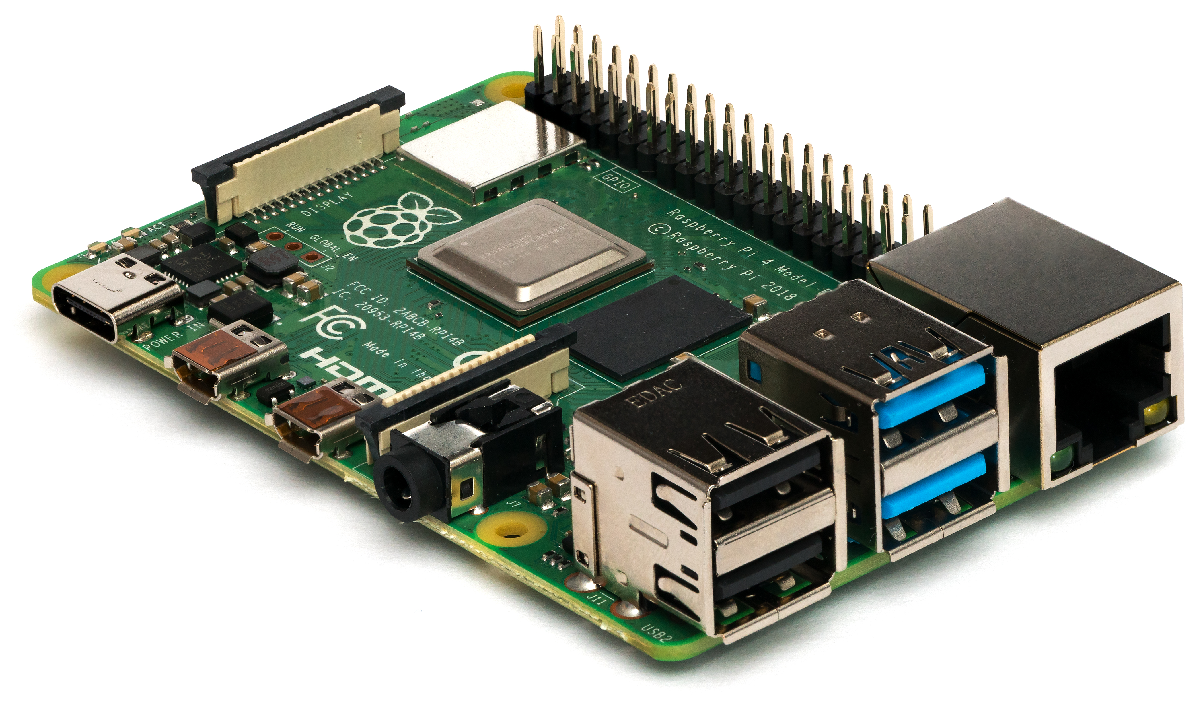
Raspberry Pi

Slide 6
Field Programmable Gate Arrays (FPGAs)
Field programmable gate arrays (FPGAs) are electronic circuits that are programmed to perform a specific function.
These semiconductor devices are based around a matrix of configurable logic blocks (CLBs) that are connected via programmable interconnects, and in essence the logic is programmed before use.
FPGAs are designed to be reprogrammed to the desired functionality requirements after manufacturing, and they can typically be reprogrammed as designs of the functionality evolve.
FPGAs and ASICs are found in a lot of custom devices, where a full-blown computer with an operating system (OS) and all that it entails is not needed.

Slide 7
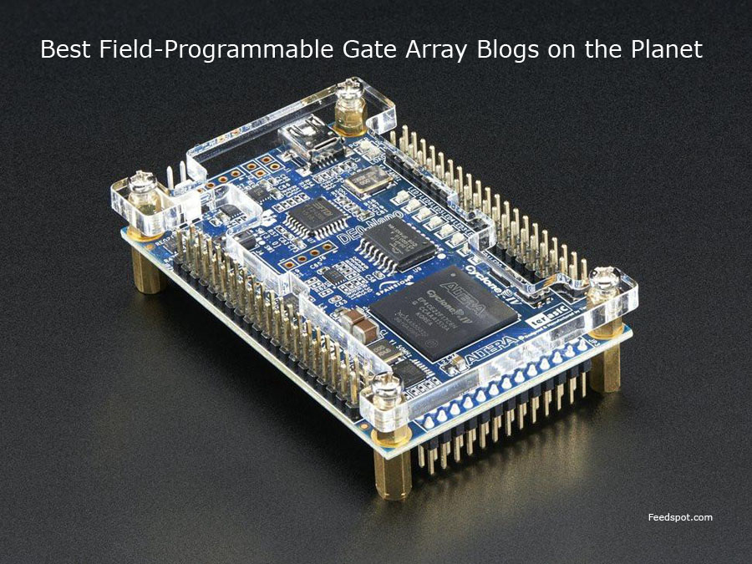
Field Programmable Gate Arrays (FPGAs)

Slide 8
Arduino
The Arduino is a single-board microcontroller, not a full-fledged computer like the Raspberry Pi.
The Arduino is simpler, designed to provide computer control to hardware projects without the overhead of a full computer, OS, and so on.
While a Raspberry Pi is designed as a computer, the Arduino is designed as a controller, specifically for interfacing with sensors and devices.

Slide 9
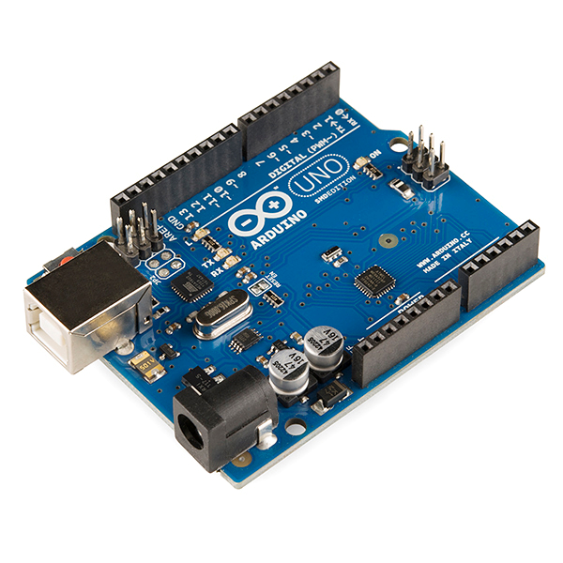
Arduino

Slide 10
Supervisory Control and Data Acquisition (SCADA) / Industrial Control System (ICS)
SCADA is designed to control automated systems in cyber-physical environments.
SCADA systems have their own smart components, each of which is an example of an embedded system.
Together they form a SCADA system, which can control manufacturing plants, traffic lights, refineries, energy networks, water plants, building automation and environmental controls, and a host of other systems.
A SCADA system is also known as a distributed control system (DCS) or an industrial control system (ICS), depending on the industry and the configuration.
Where computers control a physical process directly, a SCADA system likely is involved.

Slide 11
Supervisory Control and Data Acquisition (SCADA) / Industrial Control System (ICS)
Most SCADA systems involve multiple components networked together to achieve a set of functional objectives.
These systems frequently include a human–machine interface (HMI), where an operator can exert a form of directive control over the operation of the system under control.
SCADA systems historically have been isolated from other systems, but the isolation is decreasing as these systems are being connected across traditional networks to improve business functionality.
Older SCADA systems were air gapped from the corporate network; that is, they shared no direct network connections.
Modern systems removed this constraint and added direct network connections between the SCADA networks and the enterprise IT networks.

Slide 12
Facilities
SCADA systems find many uses in facilities, ranging from the building automation systems of the HVAC system, to pumps for water pressure, escalators and elevators, and fire alarms.
Many of these systems are independent systems where data is collected from sensors and used for a specific purpose.
Some of these systems are connected via the Internet for remote monitoring or control.

Slide 13
Industrial
Industrial facilities have some of the same needs as other facilities—the computer control of various processes, such as security, environmental monitoring, fire alarms, and more.
Each of these systems can stand alone, be partially integrated with other systems, fully integrated with others, or connected to the Internet; the combinations are almost endless and are tailored to meet the requirements of the facility.
Examples: Automobile factories, trains, traffic lights system, oil pipelines, air traffic control systems, power plants, etc.

Slide 14
Manufacturing
Manufacturing systems add another layer of computer-controlled processes to the industrial/facility mix—those of the actual manufacturing process itself.
Manufacturing equipment is commonly computer controlled, using devices such as programmable logic controllers (PLCs), to execute a process-specific set of instructions based on sensor readings and actuator settings.
These systems can be differentiated by a wide range of specific attributes, but the term SCADA is commonly used to cover them.
Because the SCADA systems that are running your manufacturing are typically very critical to your enterprise, these systems require protection from attackers.
The standard practice for this is one of strict network segmentation.

Slide 15
Energy
Energy systems range from electrical to chemical, petroleum, pipelines, nuclear, solar, hydrothermal, and more.
Each of these systems has multiple systems under computer control, typically using the same types of SCADA components as other categories already discussed.
In the case of energy distribution, such as pipelines and electricity, a further complication is the distributed nature of these elements, where they are geographically spread out (in many cases in our communities).
This distribution of components “outside the corporate walls” adds a unique physical security aspect to these systems.

Slide 16
Logistics
Logistics systems are the systems that move material from point A to point B.
These systems can involve sea, surface (roads and rail), and air transport.
There are two basic elements that will be under control: the transport system itself and the material being moved.

Slide 17
Internet of Things (IoT)
The Internet of Things (IoT) is a term used to describe a wide range of devices that connect directly via the Internet to create a distributed sensor and processing system to achieve a specific function.
IoT devices are purpose built; they are designed to do a specific task.
They all have a network interface because connectivity is their purpose as a smart device or a member of the Internet of Things.
These devices also can be mass produced and at relatively low cost.

Slide 18
Sensors
Sensors are devices that measure some physical item and return data that can be used by a system.
Sensors come in an endless array of sizes, shapes, and physical constraints.
Sensors can be used to measure temperatures, pressures, voltages, positions, humidity levels—the list goes on.
Sensors can return the data as either a digital or analog signal. Analog sensors require an analog-to-digital conversion before the data can be used by a computer, although many interface boards do this translation automatically.
When designing a system, you need to determine what needs to be measured, over what range, and at what precision, as well as environmental and other conditions; these factors all shape the specification for a sensor and determine the cost.

Slide 19
Smart Devices
Smart devices and devices that comprise the IoT have taken the world’s markets by storm.
From key fobs that can track the location of items via GPS, to cameras that can provide surveillance, to connected household appliances, TVs, dishwashers, refrigerators, crock pots, washers, and dryers—anything with a microcontroller now seems to be connected to the Web so that it can be controlled remotely.
Artificial intelligence (AI) has also entered into the mix, enabling even greater functionality, embodied in products such as Amazon Echo, Google Home, Microsoft Cortana, and Apple Siri. Computer-controlled light switches, LED light bulbs, thermostats, and baby monitors—the smart home has become a reality, connecting everything to the Internet.

Slide 20
Wearables
Wearable technologies include everything from biometric sensors measuring heart rate, to step counters measuring how far one walks, to smart watches that combine all these functions and more.
These wearable devices are built using very small computers that run a real-time operating system, usually built from a stripped-down Linux kernel.
As wearables learn more and more of your personal data, they become a source of interest for hackers. Protecting the data is the security objective for these devices.

Slide 21
Facility Automation
Low-cost sensors in an IoT package offer several advantages, including but not limited to, network delivery of data, significant data collection capability, and cost advantages with scale.
In large facilities, this means security systems, HVACs, fire sensors, and so on can provide large-scale coverage, enabling automation of data collection that used to be done manually via a person walking around.
Automation is more than just remote operation; apps such as IFTTT (If This Then That) systems can respond to changing conditions and use multiple indicators, including dates and times.
Automation can improve risk because it removes errors and improves speed of response.

Slide 22
Weak Defaults Automation
The typical process is to have default credentials on a device and then expect the user to change them.
This expectation of a user changing credentials commonly results in poor security.
Weak defaults are a condition where default conditions are generally known, including admin account and password, leaving the system completely vulnerable to an attacker.
One of the challenges of IoT deployment and security is managing literally thousands or millions of devices—and the credentials.

Slide 23
Specialized Systems
Specialized systems are systems designed for special purposes.
Four primary types of specialized systems targeted by CompTIA are
Medical devices
Vehicles
Aircraft
Smart meters.
Each of these categories has significant computer systems providing much of the functionality control for the device, and each of these systems has its own security issues.

Slide 24
Medical Systems
Medical systems is a very diverse group—from small implantable devices, such as pacemakers, to multi-ton MRI machines.
Medical devices such as lab equipment and infusion pumps have been running on computer controls for years.
The standard of choice has been an embedded Linux kernel that has been stripped of excess functionality (aka kernel pruning) and pressed into service in the embedded device.
One of the problems with this approach is how to patch this kernel when vulnerabilities are found.
Requires regression testing for problems.

Slide 25
Medical Systems
Medical devices are manufactured under strict regulatory guidelines that are designed for static systems that do not need patching, updating, or changes.
Any change would force a requalification—a lengthy, time-consuming, and expensive process.
As such, these devices tend to never be patched.
Most manufacturers simply recommended that the devices be isolated and never connected to an outside network.

Slide 26
Vehicle Systems
A modern vehicle has not a single computer in it, but actually hundreds of them, all interconnected on a bus.
The controller area network (CAN) bus is designed to allow multiple microcontrollers to communicate with each other without a central host computer.
*Not to be confused with Campus Area Network (CAN)
Newer vehicles rely on multiple computer systems, all operating semi-autonomously and with very little security.

Slide 27
Aircraft Systems
Aircraft also have a significant computer footprint inside, as most modern jets have what is called an “all-glass cockpit,” meaning the old individual gauges and switches have been replaced with a computer display that includes a touchscreen.
The connecting of all of this equipment onto busses that are then eventually connected to outside networks has led to a lot of security questions for the aviation industry.
Patching the OS for aircraft systems is a difficult process because the industry is heavily regulated, with strict testing requirements.

Slide 28
Smart Meters
Smart meters is the common name for the advanced metering infrastructure, a program initiated by the Department of Energy to bring the functionality of remote automation to meters in utilities.
Real-time two-way communications, computing infrastructure to analyze the data, and a whole host of new policies and procedures to take advantage of the automation have provided a revolution in utility operations.
For all utilities, the ability to read meters, change service, disconnect, reconnect, and detect and manage outages provides cost savings and levels of service never possible with the old manually managed meters.
Managing the large-scale deployment of infrastructure in a secure fashion requires an extensive cryptographic setup, with some meters having multiple passwords for different levels of operation.

Slide 29
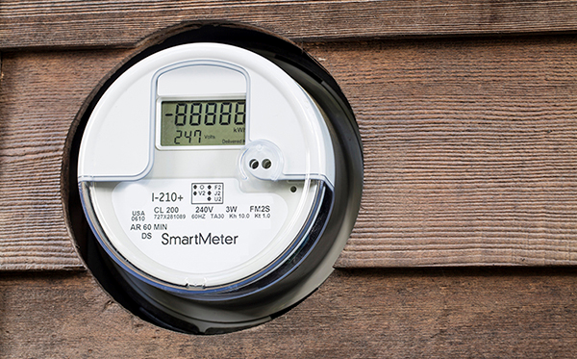
Smart Meters

Slide 30
Voice over IP (VoIP)
Voice over IP—the transmission of voice communications over IP networks—is now a commonplace method of providing telephone services.
VoIP systems require protections from standard traffic-based attacks such as denial of service, but also need protections from spoofing.
Additional risks include outsiders using your VoIP to connect to international telephony services and offering free phone calls or using your phone service to robocall people.

Slide 31

Heating, Ventilation, Air Conditioning (HVAC)
Building-automation systems, climate-control systems, and HVAC (heating, ventilation, and air conditioning) systems are all examples of systems that are managed by embedded systems.
Interconnecting these systems and adding in Internet-based central control mechanisms does increase the risk profile from outside attacks.
Case study: Target hack

Slide 32
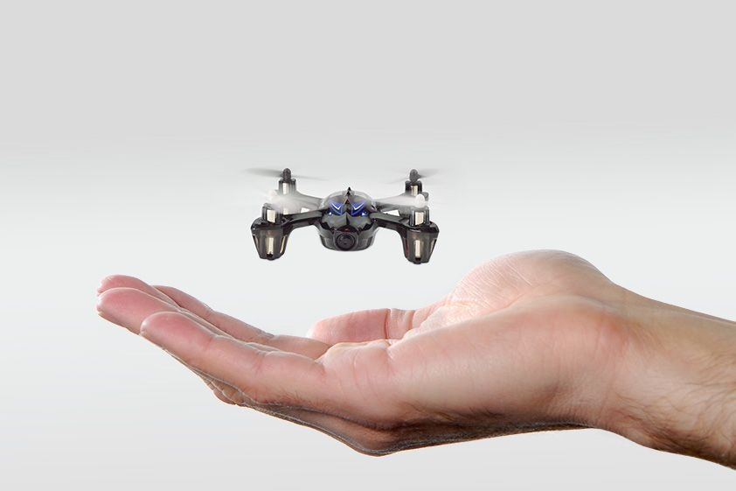
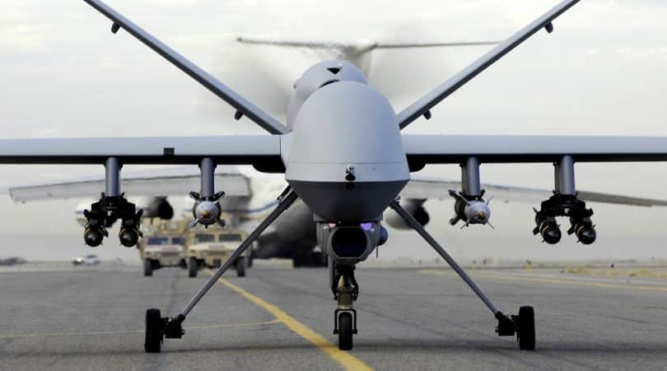
Drones
Drones, or unmanned aerial vehicles (UAVs), represent the next frontier of flight.
UAVs have cameras, sensors, and processors to manage the information, and even the simple hobbyist versions have sophisticated autopilot functions.
Because of the remote connection, UAVs are networked and operated either under direct radio control (rare) or via a networked system (much more common).

Slide 33
Multifunction Printers (MFPs)
Multifunction printers (MFPs), which combine a printer, scanner, and fax, have embedded compute power to act as a print server, manage the actual printing or scanning process, and allow complete network connectivity.
The system that runs all these functions was designed to provide maximum functionality for the device, and security is more of an afterthought than a design element.
These devices have been shown to be hackable and capable of passing malware from the printer to the computer.
Hacking embedded devices video:
https://www.youtube.com/watch?v=5GnMj5cus4A

Slide 34
Real-time Operating Systems (RTOSs)
Real-time operating systems (RTOSs) are designed for devices where the processing must occur in real time and data cannot be queued or buffered for any significant length of time.
RTOSs are not general-purpose machines but are programmed for a specific purpose.
Examples: ABS in cars or robotic arm on assembly line
The security implications surrounding real-time operating systems lie in their timing which could lead to a Race Condition.
Real-time operating systems also tend to be specific to the degree that updates and patches tend not to be common, as the manufacturer of the system does not provide that level of support.

Slide 35
Surveillance Systems
Digital surveillance systems have entered the computing world through a couple of different portals.
High-end digital cameras have networking stacks, image processors, and even 4K video feeds. These are used in enterprises such as news organizations, which rely on getting the data live without extra processing delays.
Home surveillance, baby monitors, doorbell systems (Ring), etc.
It was a network of these devices, along with a default username and password, that led to the Mirai botnet that actually broke the Internet for a while in the fall of 2016.

Slide 36
System on a Chip (SoC)
System on a chip (SoC) refers to a complete computer system miniaturized on a single integrated circuit, designed to provide the full functionality of a computing platform on a single chip.
This includes networking and graphics display.
Some SoC solutions come with memory, while others have the memory separate.
The security implications of SoC-based systems is associated not with the specifics of SoC, but in the fact that they are ubiquitous in our technology-driven lives.
Security issues are handled by the device, not the specific SoC aspect itself.

Slide 37
Communications Considerations
Embedded and specialized systems are useful for a purpose, and many times those purposes require communications across a network for other resources.
The communication considerations for embedded and specialized systems are dependent on the service, what task it is doing, and the resources needed.

Slide 38
5G
5G is the latest generation mobile radio-based network.
It is designed to connect virtually everyone and everything together, including machines, objects, and devices, with a focus on higher data speeds and bandwidth.
5G networks are more than just bigger pipes; the standard has many functional elements to improve both performance and efficiencies.

Slide 39
Narrow-Band Radio
Narrow-band radio communications use narrow bands of frequencies for low-data-rate communications.
While a low data rate may seem to be a big problem, not all systems have high-data-rate needs, and narrow-band radio offers advantages in range and power utilization.
Lower-power transmitters are the norm, as are significantly longer ranges.
So, if a company has a bunch of drilling rigs over a large geographic area and needs to move relative small quantities of data between them, then narrow-band radio can be the ideal solution.

Slide 40
Baseband Radio
Baseband refers to the original bandwidth produced by a signal.
For typical audio signals, it is 20–20,000 Hz.
For a signal to be transmitted over a radio circuit, it is usually encoded or modulated in a manner that can then be blended with the radio wave, carrying the information in the changes on a radio wave.
Baseband radio refers to the signal that is being transmitted and represents a single channel of communication.
Broadband radio is when multiple signals are bundled together for transmission, and equipment is typically required to separate out the individual communications.
Baseband radio, by design, is very simple, as it only carries a single channel to manage communications across.

Slide 41
Subscriber Identity Module (SIM) Cards
A Subscriber Identity Module (SIM) card is a device used to hold key information needed to conduct communications across telecommunication networks.
A SIM card provides a means of identifying users and other key items of information when using telecommunication networks.
The SIM card provides the information needed by the network to attribute the call.
SIM cards are important because they can contain user data and authentication information as well as provide identity services.

Slide 42
Zigbee
Zigbee is a low-power mesh radio service used to connect sensors and basic devices.
Used in smart home and commercial sectors
https://zigbeealliance.org/solution/zigbee/

Slide 43
Constraints
Specialized and embedded systems have a different set of constraints that they are designed to operate under.
Typical constraints for these devices include limitations on power, compute capacity, network throughput and bandwidth, cryptography, and cost.
Additional issues in items like authentication and trust can also be driving factors.

Slide 44
Power
Electronic circuits take power to operate, and it comes from one of several sources: a power supply connected to the grid, a battery, solar, or another type of device.
Power is a key driver in many embedded and specialized systems because it is a true limiter.
When the power supply is interrupted and no backup power supply exists, the device stops functioning.
Power drives many design elements because extra functionality that is not needed, including speed, only uses power and does not add to the functionality of the unit.

Slide 45
Compute
The compute capability of embedded and specialized systems is another key component that is matched to the task the device is designed to accomplish.
Compute performance is one of the major elements in the power equation, and excess compute capacity results in more power drain and less useful life on a battery charge.
From tiny microcontrollers the size of a grain of rice with very limited capabilities, to the ASICs designed for visual/lidar processing in modern self-driving cars, the range of capabilities is wide.
The key point to remember is that compute power, power capacity, and useful lifetime without external power are all locked in a battle, each taking from the other two.

Slide 46
Network
Network limitations are due to constraints from power and connectivity.
Networking is the key value component behind the Internet of Things revolution.
The utility of networking power is related to an exponential function associated with the number of nodes.
Larger deployments (think smart meters in a major metropolitan area) deliver tremendous quantities of data, via a network, to a data center on a regular and timely basis.
Managing large data flows places a burden on the central site, which if not properly planned for and executed becomes a constraint on the overall system operation.

Slide 47
Cryptographic Functions
Cryptographic functions can be essential to secure data during transmission, but this functionality comes at a price.
The level of computational resources for crypto functions can be substantial, thus becoming a constraint on the overall system.
Lightweight cryptographic algorithms are being developed to specifically address these challenges, and these are covered in Chapter 16, “Cryptographic Concepts.”

Slide 48
Inability to Patch
The inability to patch an item represents a security risk and a constraint. (Immutable system)
This is typically caused by a series of design decisions predicated on producing items that are not computers but rather single-purpose devices.
While Raspberry Pi’s and Arduinos may get patches from their developers, the embedded controller in a surveillance camera is another story altogether.
Simply put, the ecosystem for most embedded devices is missing the means, the culture, and in many cases the sheer ability to manage the patch process.

Slide 49
Authentication
Authentication is an important predicate to security functionality.
This is a serious concern regarding embedded systems.

Slide 50
Range
In most cases, range is a function of power—one of the true limitations of many specialized and embedded systems.
One of the challenges of IoT deployments is getting them to the Internet, because their range is unlimited.
However, this comes at the cost of security/risk.

Slide 51
Cost
The whole purpose behind developing specialized/embedded systems is that the value is there.
The functionality return for the cost of the unit justifies the design and deployment, so cost is to a degree baked in.
So, rather than viewing cost as a constraint, it is the factor that drives the creation of these solutions.
However, cost is also an economic issue because extra functionality leads to extra cost, and if this functionality isn’t needed in the final solution, money is wasted.

Slide 52
Implied Trust
Implied trust, by definition, is trust that has not been specifically set up but yet exists.
This is almost a given in many specialized systems because they are not intended or designed to be general-purpose compute devices; therefore, the thought processes associated with regular trust vis-à-vis computers and the Internet do not exist.
This makes for easier connectivity, but also opens doors for an attacker.

